Slide 1
Aim 15. Multiplying a Polynomial by a Monomial

Slide 2
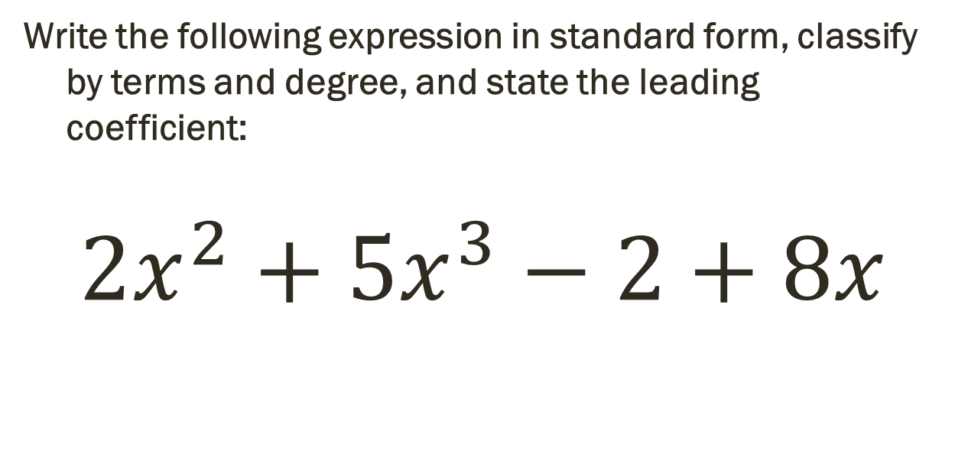
Do Now Quiz
Write the following expression in standard form, classify by terms and degree, and state the leading coefficient:
$$2x^{2}+5x^{3}−2+8x$$

Slide 3
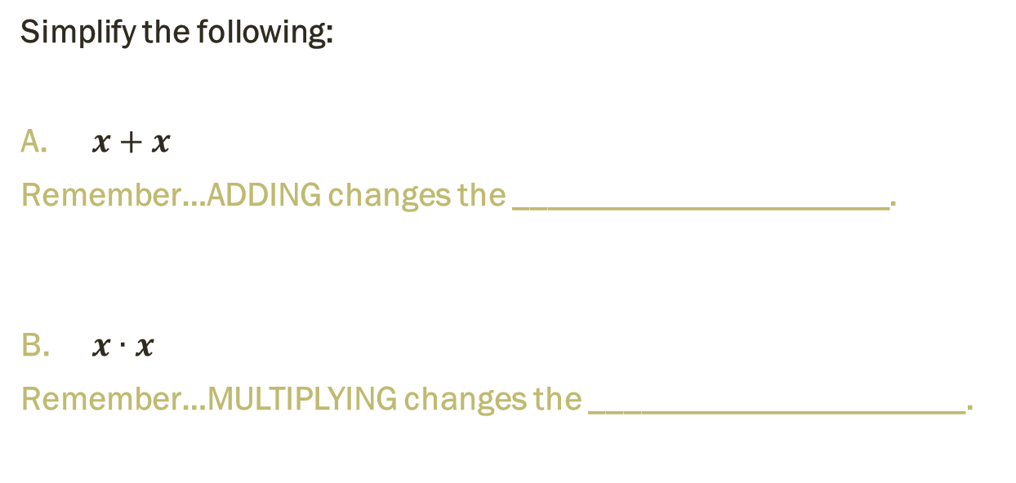
Review: Are you ready?
Simplify the following:
$x+x$
Remember…ADDING changes the ______________________.
B. $x∙x$
Remember…MULTIPLYING changes the ______________________.

Slide 4
Multiplying a Polynomial by a Monomial
Example 1:
Distribute the monomial to each term in the polynomial!
$$6y(4y^{2}−9y−7)$$

Slide 5

Practice! (1A)
$$3x(2x^{2}+3x+5)$$

Slide 6

Practice! (1B)
$$5a^{2}(−4a^{2}+2a−7)$$

Slide 7
Multiplying a Polynomial by a Monomial…More than once! ☺
Example 2:
Distribute the monomial to each term in the polynomial!
$$3\left(2t^{2}−4t−15\right)+6t(5t+2)$$

Slide 8

Practice! (2a)
$$5 \left(4y^{2}+5y−2\right)+2y(4y+3)$$

Slide 9

Practice! (2B)
$$3\left(5x^{2}+2x−4\right)−x(7x^{2}+2x−3)$$

Slide 10

Multiplying a Polynomial and solving
Example 3:
$$b\left(12+b\right)−7=2b+b(−4+b)$$

Slide 11

Practice! (3A)
$$\left(2x^{2}+2\right)+2x\left(x−3\right)=4x\left(x−5\right)−12$$

Slide 12

Practice! (3B)
d$\left(d+3\right)−d\left(d−4\right)=9d−16$

Slide 13
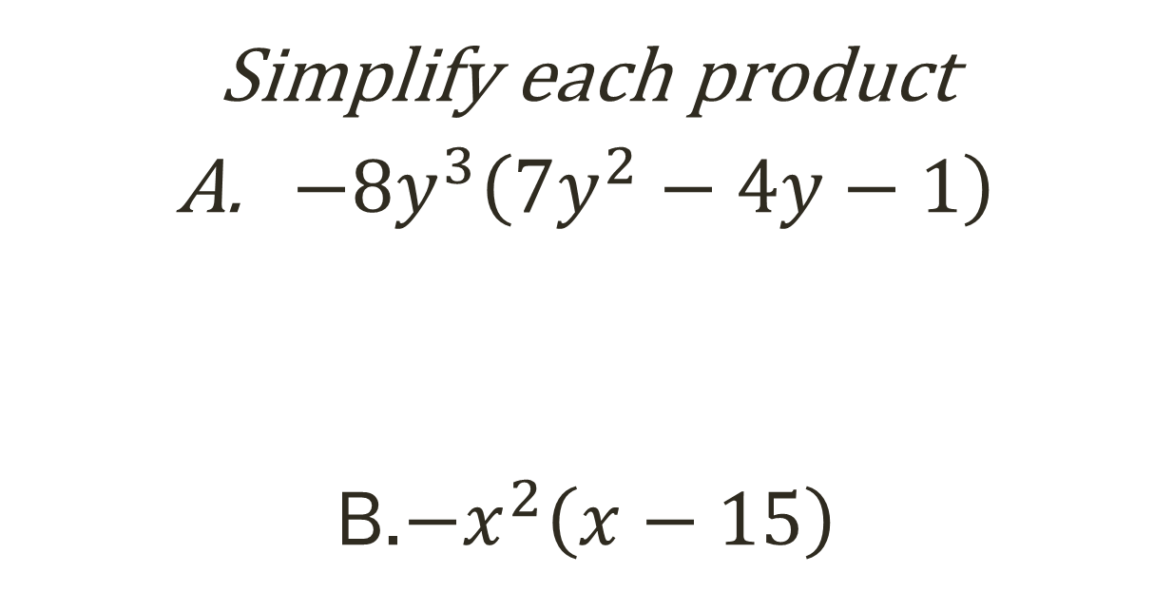
Exit slip
Simplify each product
$−8y^{3}\left(7y^{2}−4y−1\right)$
B.$−x^{2}\left(x−15\right)$

Slide 14
Admission to Coney Island is $10. Once in the park, cyclone is an additional $3 per ride and visiting hunted house is an additional $2. Maria goes to Coney Island and rides 15 rides, of which s of those 15 are super rides. Find the cost if Bethany rode 9 super rides.

